Slide 1
Guinea Pigs
True or false ?

Slide 2
Q1: Are guinea pigs really cute ?
True or false ?

Slide 3
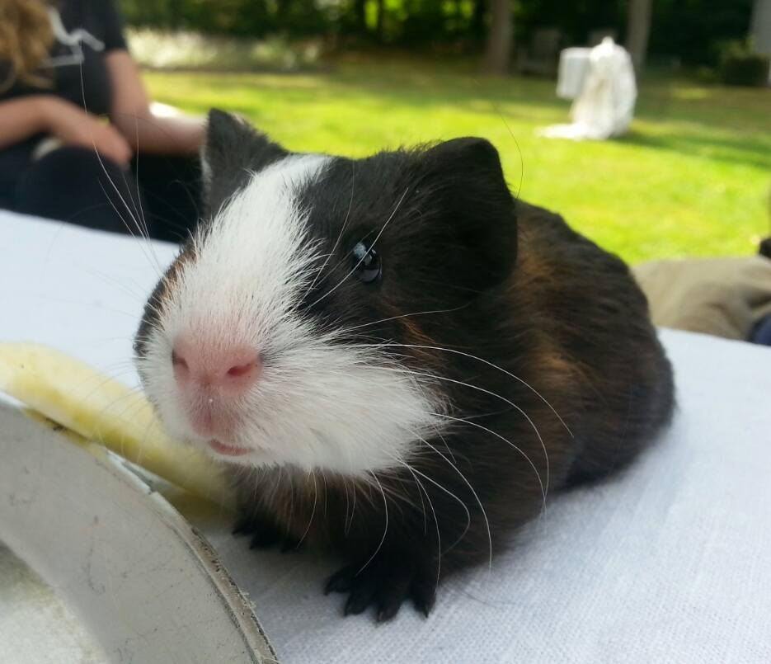
Yes, they are !
Guinea pigs are rodents
Different kinds of guinea pigs:
Cavia
Galea
...
From South America
Prepared for survival

Slide 4
Q2: Do guinea pigs eat pizza ?
True or false ?

Slide 5
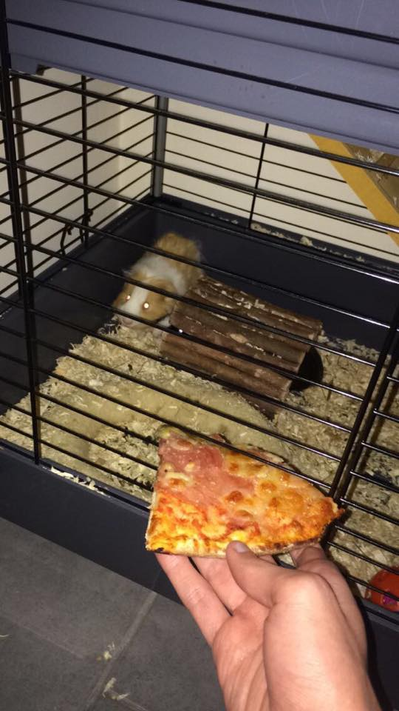
No …
Herbivore: endive, tomato, …
Hay = main food
Coprophagic
Vitamin C

Slide 6
Q3: Do guinea pigs always want to fight ?
True or false ?

Slide 7
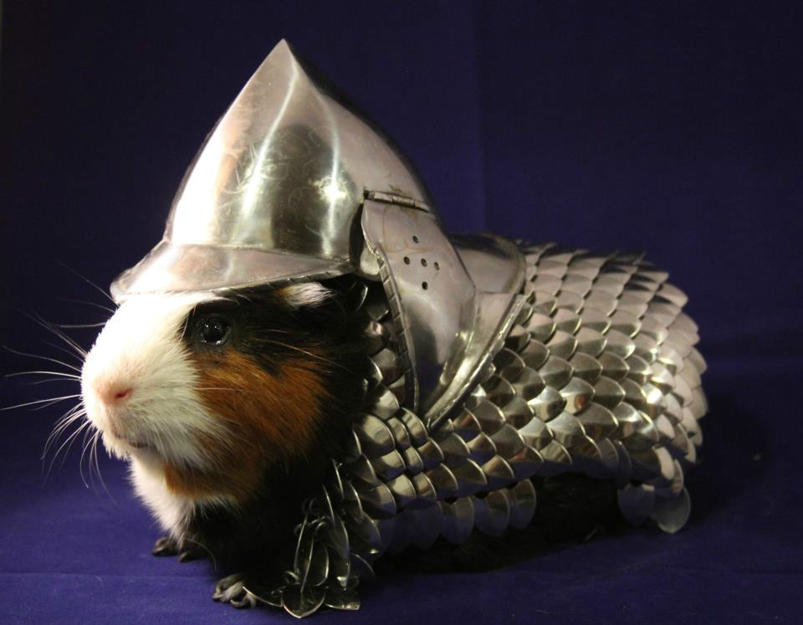
Yes and no
Different noises:
« brr brr »
« pouik pouik »
More infos
Live in groups
Dominance
Behaviour with humans

Slide 8
Q4: Can we eat guinea pigs ?
Warning: The following pictures and/or content may be disturbing to some viewers. Viewer discretion is strongly advised

Slide 9
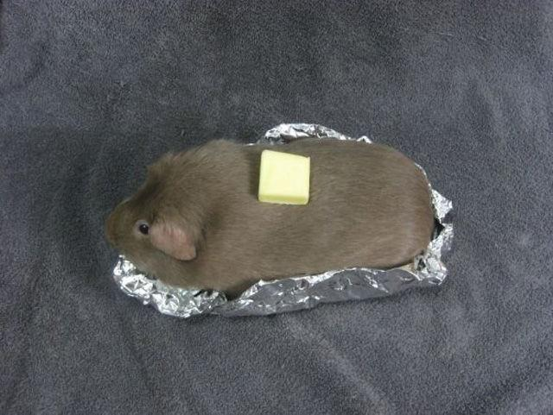
Yes
In tropical countries
Tastes like rabbit

Slide 10
Q5: Guinea pigs are good lovers
True or false ?

Slide 11
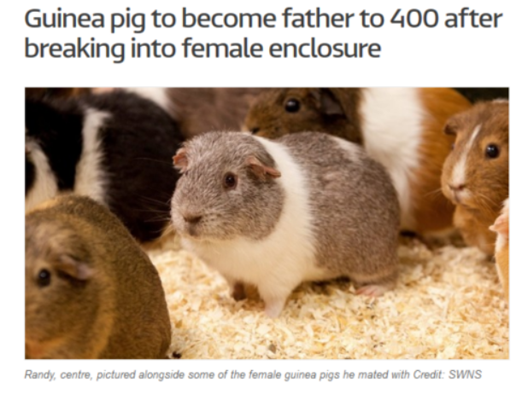
Yes
As soon as 3 months old
2 to 4 times a year
Pregnancy lasts 64 days

Slide 12
